Slide 2
CHAPTER 23
Managing Architecture Debt

Slide 3
Some debts are fun when you are acquiring them, but none are fun when you set about retiring them.
—Ogden Nash

Slide 4
Chapter Outline
Introduction
Determining Architecture Debt Problems
Structural Dependencies
Evolutionary Dependencies
Discovering Hotspots
Examples
Identifying Hotspots
Quantifying Architecture Debt
Automation
Summary

Slide 5
Introduction
What Is Architecture Debt?
In software development technical debt is the consequences of choosing quick, easy solutions in over more robust, long-term solutions.
Designs become harder to maintain and evolve over time; we call this entropy architecture debt, a costly form of technical debt.
Why It’s Hard to Manage?
Architecture debt is more difficult to detect and eradicate than code debt because it involves non-local concerns.
Tools for discovering code debt—code inspections, code quality checkers, and so forth—typically do not work well for detecting architecture debt.
Not all debt is bad; sometimes principles (like low coupling or high cohesion) are sacrificed for worthy trade-offs, such as improving runtime performance or time to market.

Slide 6
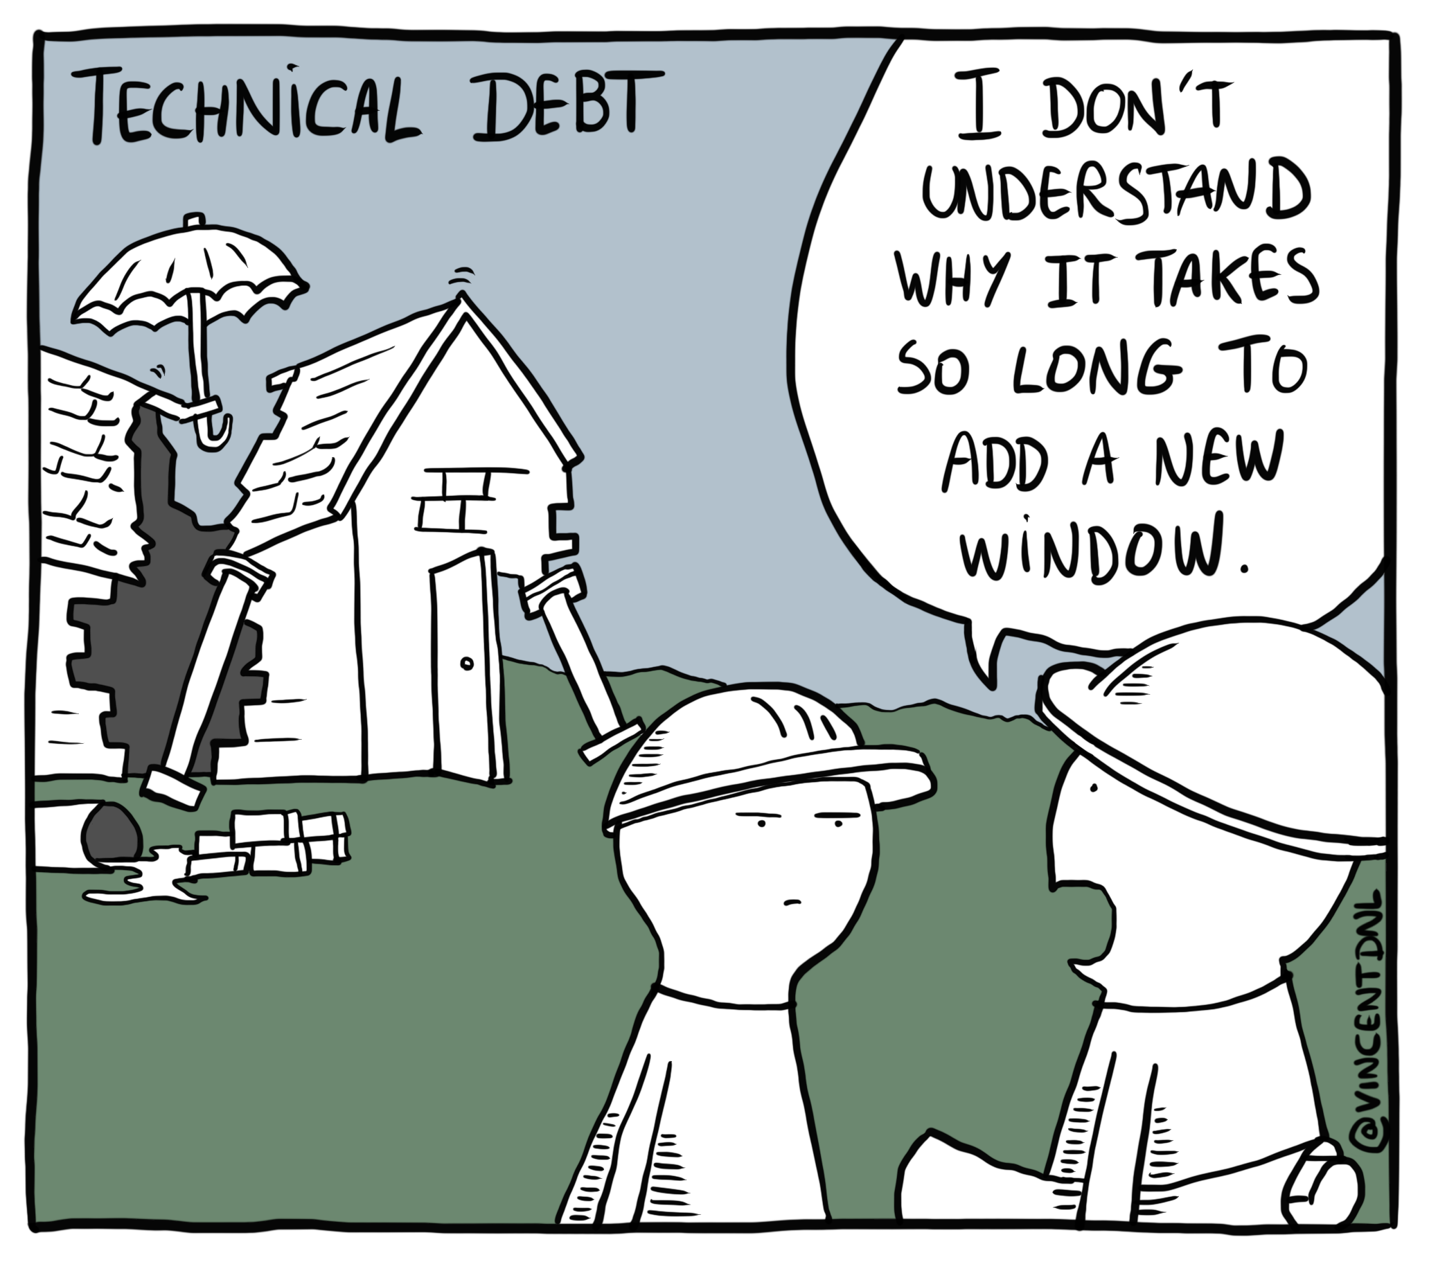
Technical debt

Slide 7
Introduction
This chapter introduces a process to analyze existing systems for architecture debt.
Paying Down Debt: The Business Case
Once identified, architecture debt should be removed through refactoring.
Quantitative evidence of payoff is needed to persuade stakeholders.
framed in terms of ROI (Return on Investment) and increased productivity.
not just “three months of refactoring with no new functionality”.
The process that we advocate requires three types of information:
Source code to determine structural dependencies.
Revision history to determine co-evolution of code units. (using VCS)
Issue information to determine the reasons for changes.

Slide 8
Determining Architecture Debt Problems
In our process for managing architecture debt, we focus on the files in which source code is stored.
Architecturally connected files are identified by:
static dependencies: extracted via a static code analysis tool.
evolutionary dependencies: extracted from revision history when files co‑change.
For example, using git to analyze which files change together.
Representing Dependencies with a DSM
A design structure matrix (DSM) is an adjacency matrix where both rows and columns list files in the same order, and cells are annotated to show dependency types.
Cells show structural relations (inheritance, calls) or evolutionary relations (co‑changes in history).

Slide 9
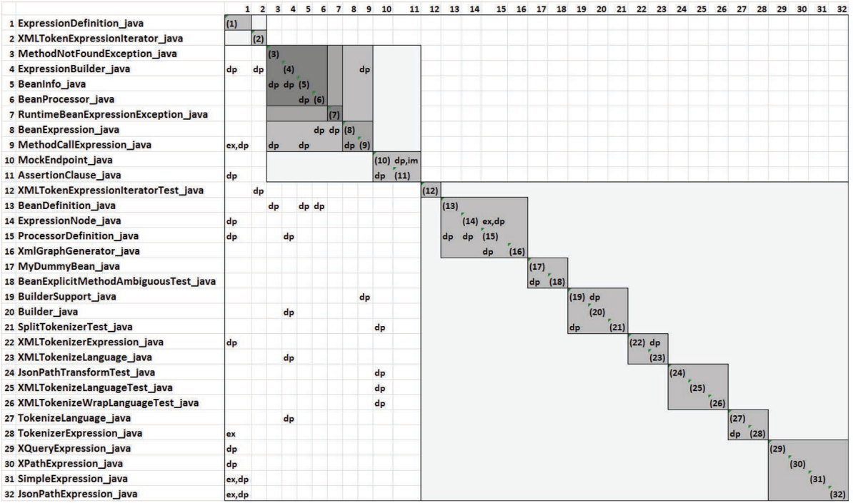
A DSM of Apache Camel showing structural dependencies

Slide 10
Structural Dependencies
Previous page figure is DSM of structural dependencies for 11 Camel files.
Camel is an open-source java framework.
Dependency, implementation, and extension, indicated by the labels “dp,” “im,” and “ex”.
For example, The file on row 9 of this Figure (MethodCallExpression.java) depends on and extends the file on column 1 (ExpressionDefinition.java).
These static dependencies are extracted by reverse-engineering the source code.
Interpreting a DSM
A sparse, lower‑diagonal DSM indicates low coupling and no cyclic dependencies
A dense or above‑diagonal DSM signals problematic coupling
Example DSM is sparse. these files aren’t heavily structurally coupled, suggesting low architecture debt.

Slide 11
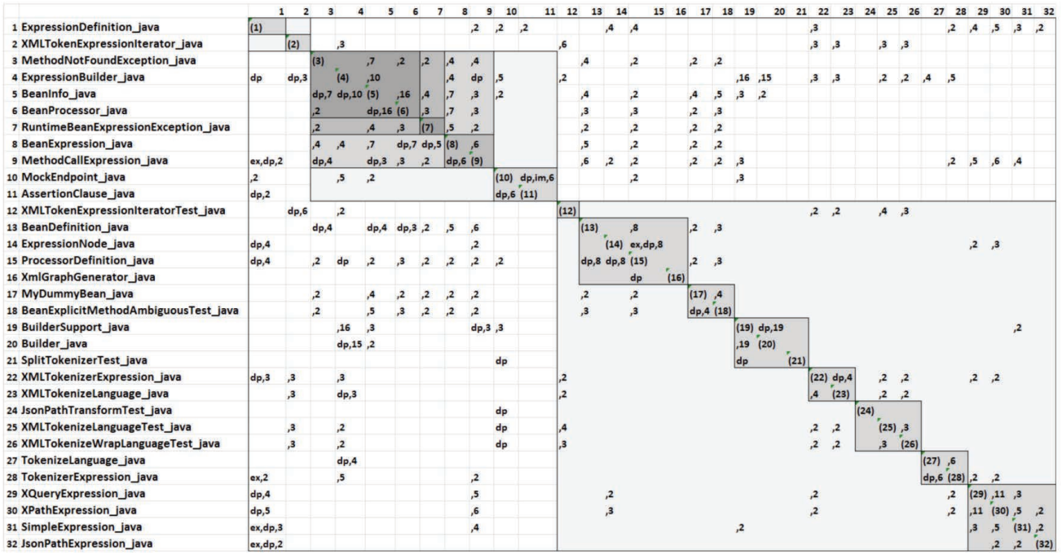
A DSM of Apache Camel showing evolutionary dependencies

Slide 12
Evolutionary Dependencies
Previous figure shows a dense DSM with many above‑diagonal entries, revealing strong evolutionary coupling and high debt.
For example, XMLTokenizerExpression.java depends on ExpressionDefinition.java and they co‑changed three times (marked ‘dp, 3’).
Architects report that dense evolutionary coupling leads to costly, complex changes and unpredictable delivery of features and bug fixes.
We can automatically quantify debt by identifying ‘hotspots’; areas of the architecture with concentrated design flaws.
Hotspots are modules that exhibit both high coupling and high maintenance cost, guiding targeted refactoring.

Slide 13
Discovering Hotspots
If bug rates are rising and feature velocity is slowing, you need to pinpoint the specific files and flawed relationships causing architecture debt.
Architecture debt root causes are often distributed across multiple files and their interrelationships, making them hard to observe without automation.
Hotspots are sets of elements that make outsized contributions to maintenance costs due to high coupling and low cohesion.
We detect hotspots by identifying six common anti-patterns: unstable interface, modularity violation, unhealthy inheritance, cyclic dependency (clique), package cycle, and crossing.

Slide 14
Discovering Hotspots
Unstable interface: A key file with many dependents changes frequently alongside those dependents.
Modularity violation: Structurally independent files change together often.
Unhealthy inheritance: A parent class depends on a subclass, or a client depends on both parent and child classes.
Cyclic dependency (clique): A group of files forms a strongly connected graph of mutual dependencies.
Package cycle: Two or more packages depend on each other instead of forming a proper hierarchy.
Crossing: A file with high fan-in and fan-out also co-changes frequently with its dependents and dependencies.

Slide 15
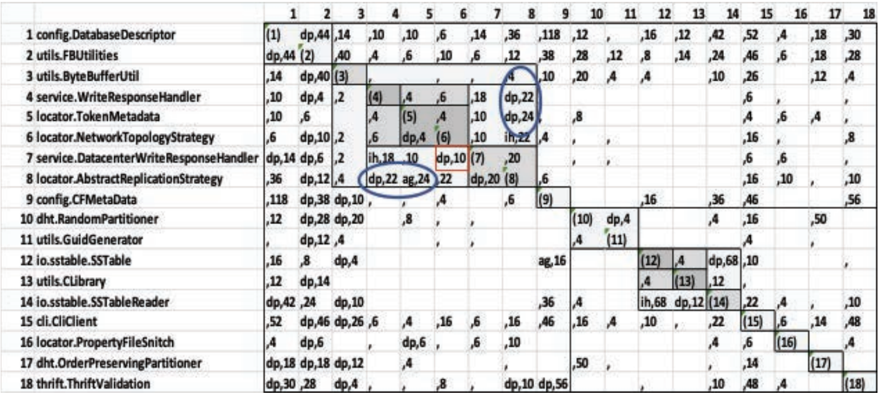
An example of a clique

Slide 16
Discovering Hotspots
Each such collection of tightly coupled files is a potential hotspot and candidate for debt removal, through refactoring.
Previous figure is a DSM based on files in Apache Cassandra—a widely used NoSQL database. It shows an example of a clique (a cycle of dependencies).
In this DSM, you can see that the file on row 8 (locator.AbstractReplicationStrategy) depends on file 4 (service.WriteResponseHandler) and aggregates file 5 (locator.TokenMetadata). Files 4 and 5, in turn, depend on file 8, thus forming a clique.

Slide 17
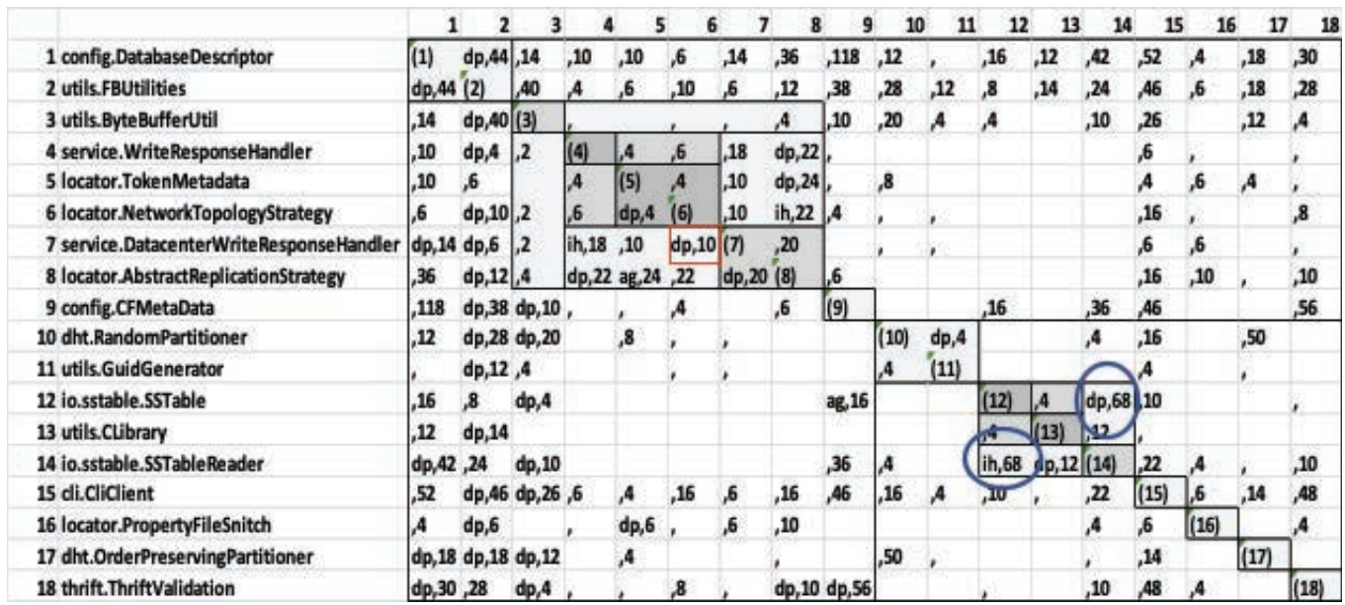
Architecture anti-patterns in Apache Cassandra

Slide 18
Discovering Hotspots
Another example from Cassandra demonstrates the unhealthy inheritance anti-pattern.
The DSM in the previous figure shows the io.sstable.SSTableReader class (row 14) inheriting from io.sstable.SSTable (row 12).
The inheritance relationship is indicated in the DSM by the “ih” notation.
Note, however, that io.sstable.SSTable depends on io.sstable.SSTableReader, as indicated by the “dp” annotation in cell (12, 14).
This dependency is a calling relation, which means that the parent class calls the child class.
Note that the cells (12, 14) and (14, 12) both have number 68. This represents the number of times that io.sstable.SSTable and io.sstable.SSTableReader were co-committed in changes.
This excessively high number of co-changes is a form of debt.
This debt can be removed by moving some functionality from the child class to the parent.

Slide 19
Example: Identifying Hotspots
We illustrate this process with a case study, which we call SS1, done with SoftServe, a multinational software outsourcing company.
We identified hotspots using the process just described.
Three clusters of architecturally related files emerged as hotspots, totaling 291 files (about one-third of the system).
The number of defects associated with these three clusters covered 89 percent of the project’s total defects.
The chief architect of the project agreed that these clusters were problematic but had difficulty explaining why.

Slide 20
Example: Quantifying Architecture Debt
This section quantifies the cost and benefits of refactoring SS1’s identified architecture debt.
Refactoring cost estimate: 14 person-months to remediate the three hotspots.
Company average bug-fix rate: 0.33 fixes per file per year across the project.
Hotspot files averaged 237.8 bug fixes annually before refactoring.
Conservatively assuming post-refactor rate equals company average yields 96 fixes, translating to 41.35 person-months saved per year.
Return on investment: 14 months spent yields over 41 months saved, improving feature velocity and reducing bug-fix time.
In case after case, we have seen these kinds of returns on investment.

Slide 21
Automation
This form of architectural analysis can be fully automated.
Each of the anti-patterns can be identified in an automated fashion.
This analysis process requires the following tools:
A tool to extract a set of issues from an issue tracker
A tool to extract a log from a revision control system
A tool to reverse-engineer the code base, to determine the syntactic dependencies among files
A tool to build DSMs from the extracted information and walk through the DSM looking for the anti-patterns
A tool that calculates the debt associated with each hotspot

Slide 22
Summary
This chapter has presented a process for identifying and quantifying architecture debt in a project. Architecture debt ,compared to code-based debt, is often harder to identify because its root causes are distributed among several files and their interrelationships.
The process outlined in this chapter involves gathering information from the project’s issue tracker, its revision control system, and the source code itself.
Using this information, architecture anti-patterns can be identified and grouped into hotspots, and the impact of these hotspots can be quantified.
Once architecture debt has been identified, if it is bad enough, it should be removed through refactoring.

